Slide 1
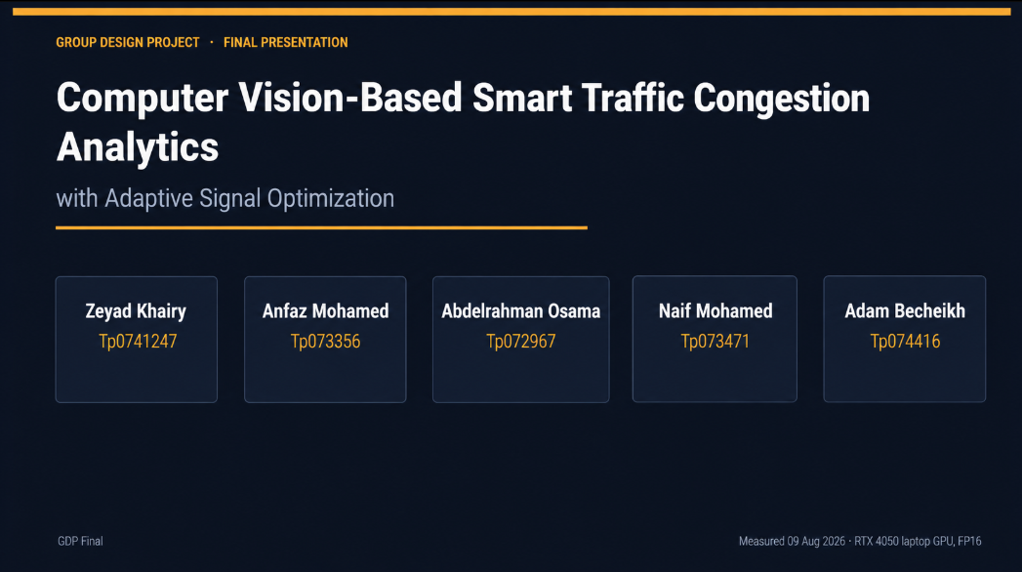

Slide 2
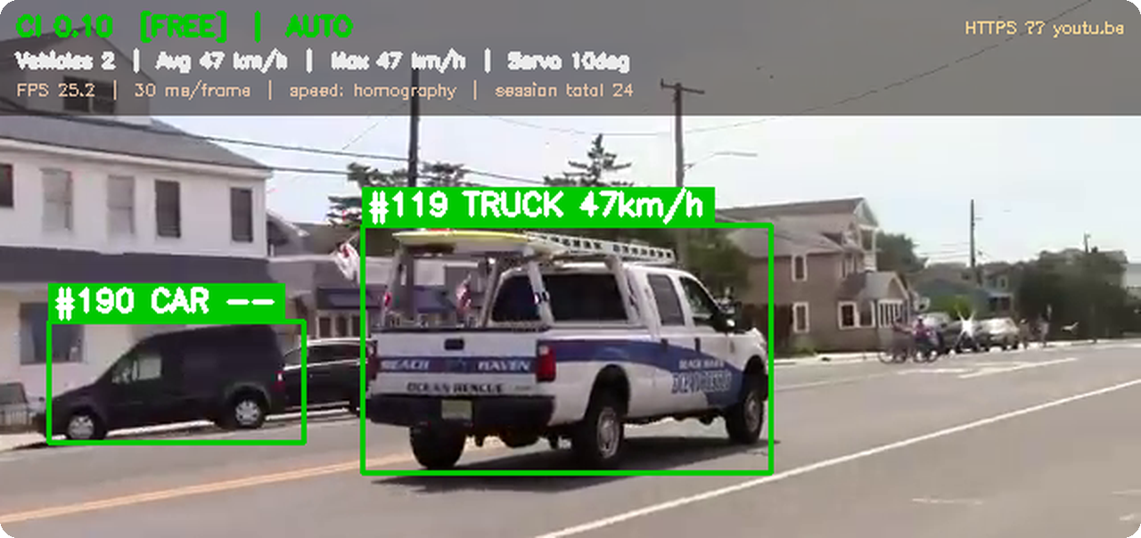
Live detection — tracked IDs, per-vehicle km/h, congestion index and signal state, computed on-device.
36.6 fps
Detector throughput
yolo11m @ 1280 px, FP16
±5%
Speed accuracy
calibrated — exact on ground truth
0
False alarms, night footage
down from 29% of all traffic
769
Automated checks
7 suites, all passing
Zeyad Khairy · GDP Final
Measured 09 Aug 2026 · RTX 4050 laptop GPU, FP16

Slide 3
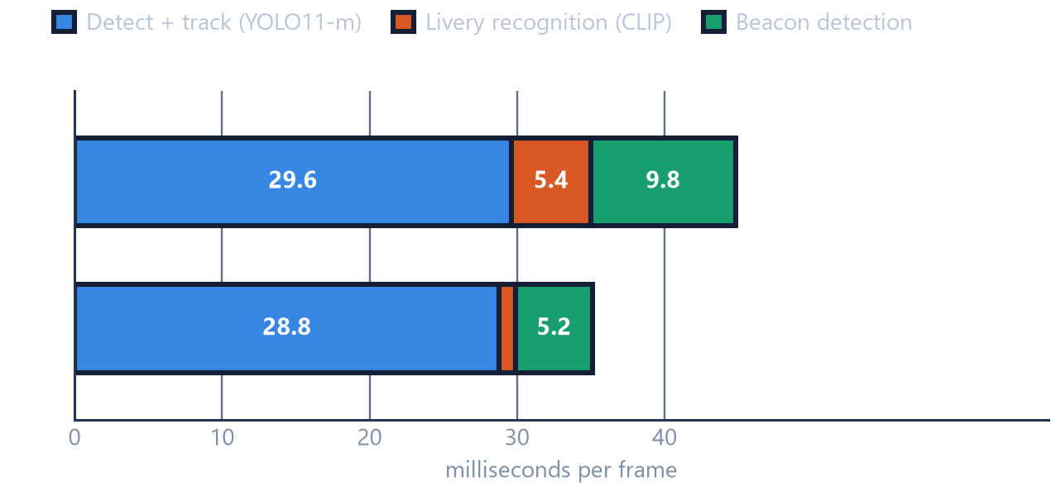
PERFORMANCE
02 / 06
Real time, end to end, on one laptop GPU
Cost of one frame, by stage
The pipeline
01
Camera or video in
1080p, media-clock timed
02
YOLO11-m @ 1280 + ByteTrack
boxes and persistent IDs
03
Homography → km/h
real metres, not pixels
04
Congestion index + emergency fusion
livery ✕ beacon, two cues
05
Serial → Uno / ESP32
lights, LCD, LED strip, servo
Detection dominates.
66% of the night budget, 82% of the day one — the only stage worth optimising.
Both recognisers cost more at night.
Dark crops fail the readability gate and retry; and at night there are real beacons to measure.
22–28 fps end to end.
Every stage included, no cloud round-trip, no frame dropping.
Zeyad Khairy · GDP Final
Measured 09 Aug 2026 · RTX 4050 laptop GPU, FP16

Slide 4
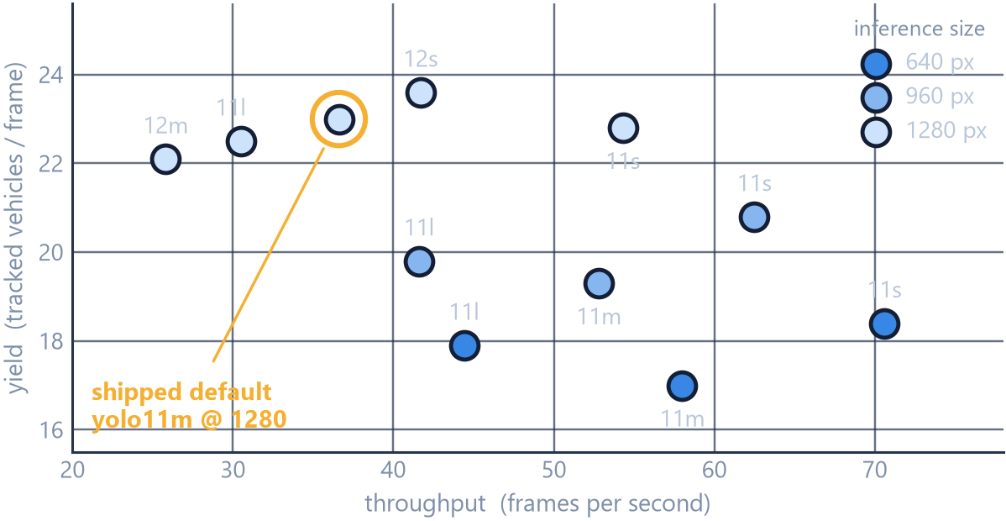
MODEL SELECTION
03 / 06
Why yolo11m at 1280 — and what we left on the table
11 configurations, 60 consecutive night frames
Resolution buys detections. Model size does not.
Every model gains about 5 vehicles per frame going 640 → 1280. At a fixed resolution, s → l gains nothing: yolo11l finds fewer than yolo11m for 20% more time. The limit is how many pixels a distant vehicle occupies.
YOLO12 is the wrong family here
yolo12m @ 1280 is the slowest row measured (38.7 ms) and still finds fewer vehicles than yolo11m. Its attention blocks cost real time on an Ada laptop GPU.
⚠ Left on the table, on purpose
yolo11s @ 1280 comes within 1% of that yield (22.8 vs 23.0) at 48% more throughput. Vehicles-per-frame is a count, not a correctness score — with no labelled boxes, a model that draws more boxes cannot be told from one that draws better ones. The default stays until there is a real mAP.
Zeyad Khairy · GDP Final
Measured 09 Aug 2026 · RTX 4050 laptop GPU, FP16

Slide 5
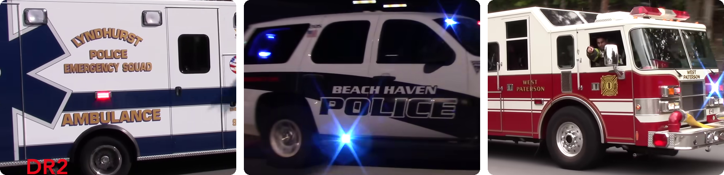
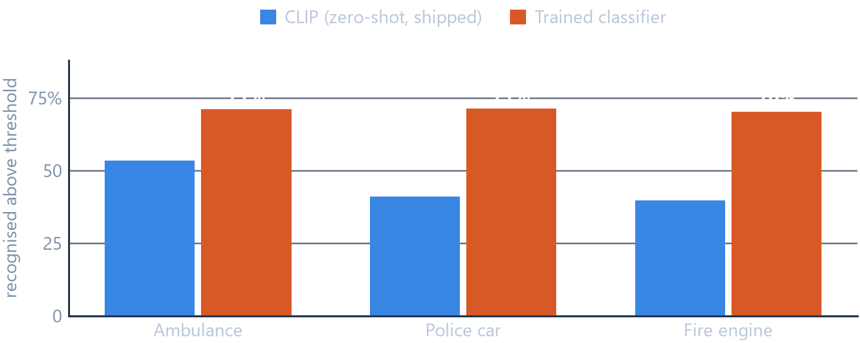
EMERGENCY RECOGNITION
04 / 06
Two cues, because appearance alone is not evidence
29% → 0
False alarms on the night footage. Livery alone flagged 88 of 299 ordinary vehicles. Requiring a beacon that actually flashes — 0.7–6 Hz, 3+ flashes, sustained over a second — took that to zero.
AMBULANCE
POLICE CAR
FIRE TRUCK
On unseen internet footage
An 11:43 compilation, nothing cherry-picked:
frames analysed 21,083
vehicles tracked 2,511
flagged as emergency 166 (6.6%)
by type 60 fire · 59 amb · 47 police
CLIP vs the trained classifier
On the one camera the classifier was trained for, it wins. On any other camera it collapses — so CLIP ships.
Why CLIP is the default
On cameras it had never seen, the trained model missed a daylight ambulance (0.55) and flagged 6 of 8 ordinary night cars. CLIP flagged 0 of 8, and none of 4,186 daylight detections.
Zeyad Khairy · GDP Final
Measured 09 Aug 2026 · RTX 4050 laptop GPU, FP16

Slide 6
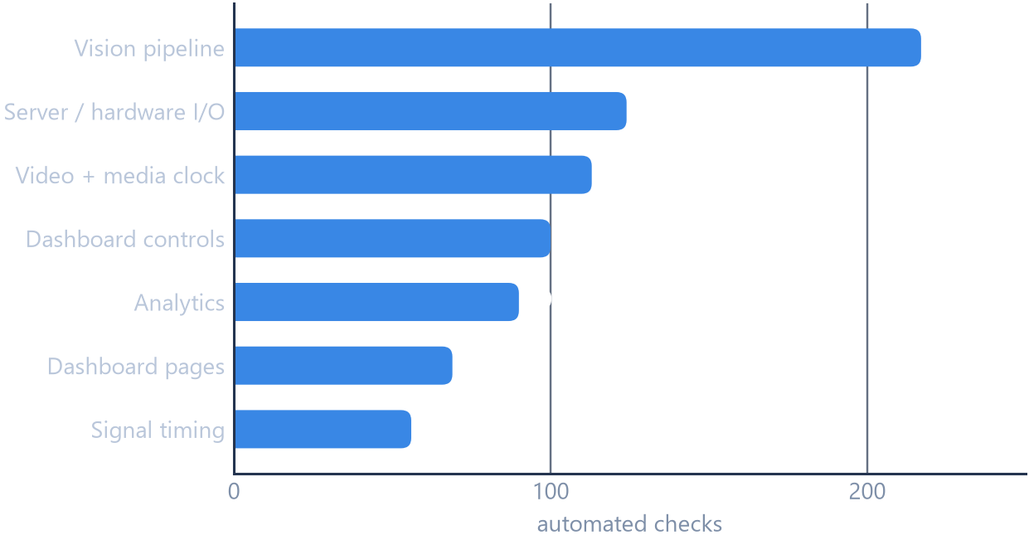
VALIDATION
05 / 06
Measured against ground truth, not against a demo
Speed, against constructed ground truth
The vehicle is synthetic, so its speed is known rather than estimated.
769
automated checks, all passing
Across the whole stack — vision, hardware I/O, media clock, dashboard, analytics and signal timing.
Homography mode
18 km/h
18.00
Homography mode
36 km/h
36.00
Homography mode
72 km/h
72.00
Parked vehicle
0 km/h
0.12
Field error: ±5% calibrated, ±25% automatic.
The media clock, and the signal
A vehicle scripted at 16.2 km/h through a real MP4, played at real time, 2×, half speed and unthrottled — all four measure 16.2 km/h. Reported speed is a property of the traffic, not of the computer.
Yellow is exactly 5 s, every time. With congestion flipping every 0.5 s for two minutes, no phase is ever momentary and R→Y→G→Y→R never breaks.
Minimum dwell — 3 s by default — is held on green and red, so a phase can never be skipped no matter how fast the traffic changes.
Signal timing is driven against a synthetic clock rather than by sleeping, so intervals are asserted exactly.
Zeyad Khairy · GDP Final
Measured 09 Aug 2026 · RTX 4050 laptop GPU, FP16

Slide 7
WHERE IT STANDS
06 / 06
What the numbers prove — and what they do not
PROVEN
NOT CLAIMED
NEXT
22–28 fps end to end on a laptop GPU, every stage included.
Speed exact against ground truth, and invariant to playback rate.
Beacon rule took night false alarms from 29% to zero.
769 automated checks green across the whole stack.
No mAP. There are no hand-labelled boxes for this footage, so benchmark.py refuses to print an accuracy figure rather than quote COCO.
The 6.6% flag rate is a selectivity figure, not a measured false-positive rate.
Only 21 of 166 reached beacon-confirmed priority — in daylight a bright beacon blooms to white, and white fails the purity gate by design.
A few hundred labelled frames → a real mAP, which settles whether yolo11s @ 1280 should replace the default at +48% throughput.
A per-camera trained head wherever the camera is fixed — 0.7 ms per crop against CLIP's 4.3 ms, on the camera it knows.
Multi-junction coordination over the same telemetry link.
Thank you — questions welcome
Every figure in this deck is reproducible: python benchmark.py --source <clip> --grid --stages

